Slide 1
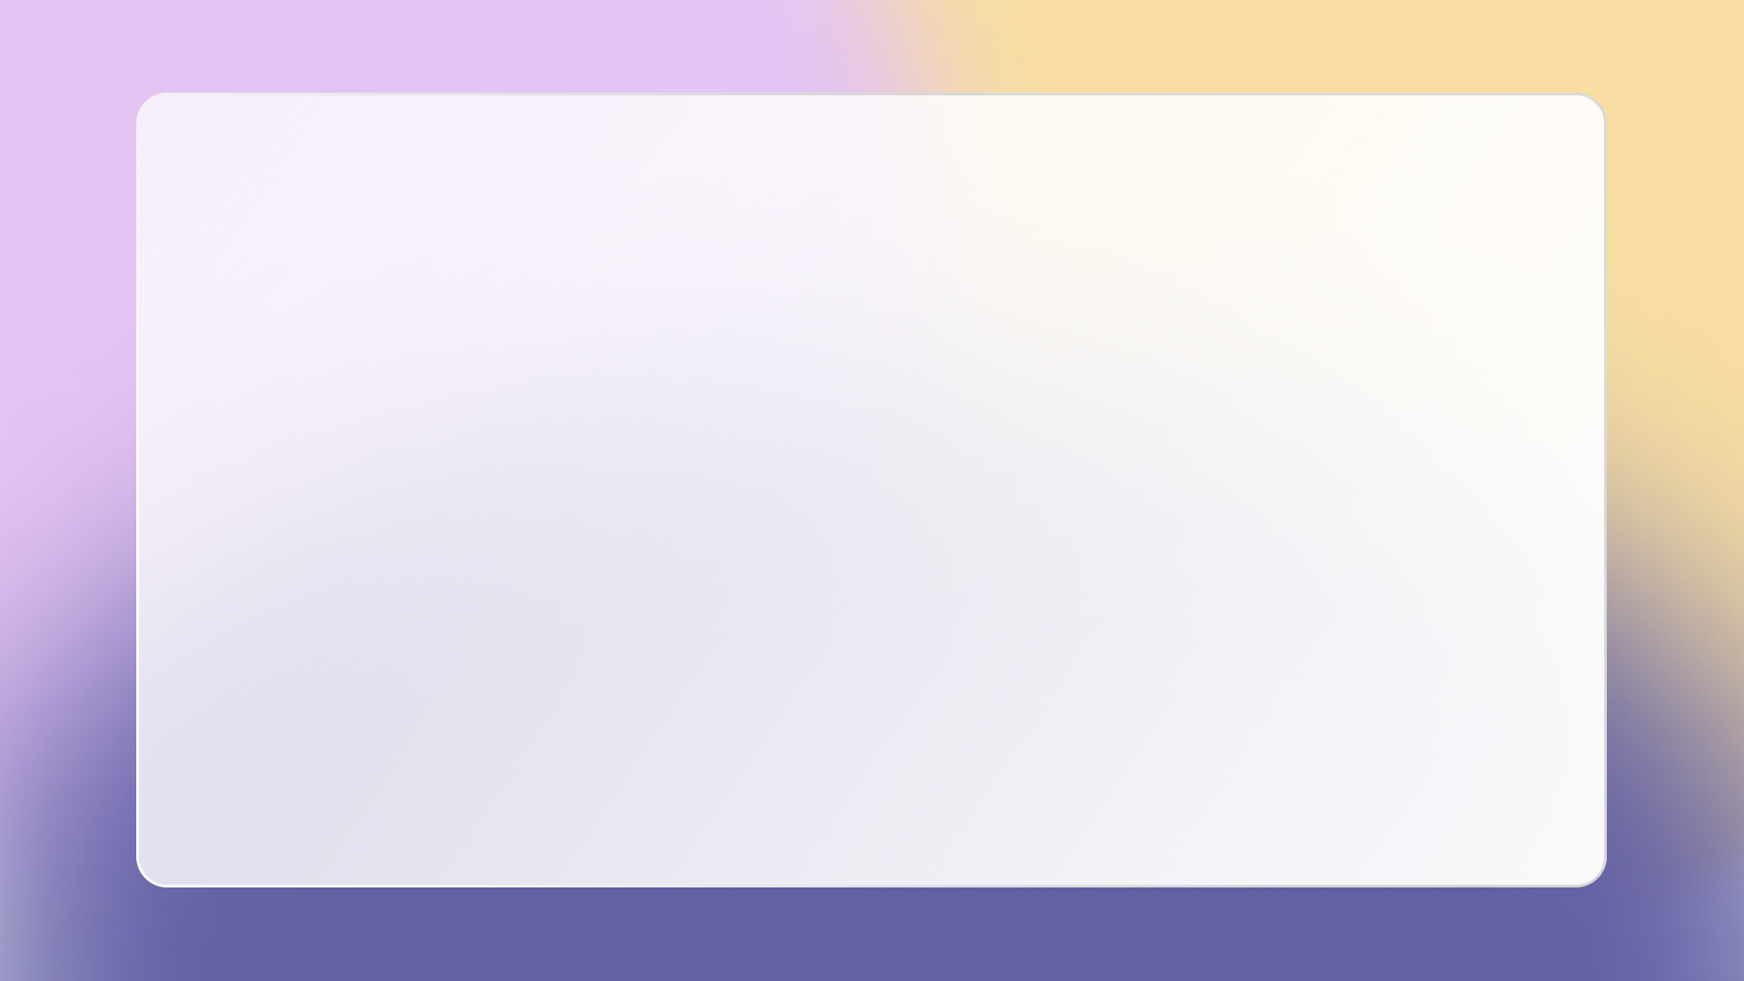
WELLCOME
Desktop Application Development
LOGIN
LECTURE: Nguyen Van Tan
GROUP 2

Slide 2

















G2
Search...
Admin
Battle Universe
Dec 2022
Su
Mo
Tu
We
Th
Fr
Sa
27
28
29
30
1
2
3
4
5
6
7
8
9
10
Introduce Game
Design Game
Database and DLL
11
12
13
14
15
16
17
Total about the game
Support software: Figma
18
19
20
21
22
23
24
More
More
More
25
26
27
28
29
30
31
Ho Lam Gia Khanh
Designer
Tran Cao Minh Thang
Coder
Coding Game
Demo Game
Support software: Visual Studio
Image Game
More
More

Slide 3
G2
Search...
Admin
HO LAM GIA KHANH
205051905
CLASS : 221.ITE1264E.B04E
GROUP 2
TRAN CAO MINH THANG
205051813
CLASS : 221.ITE1264E.B04E
GROUP 2

Slide 4
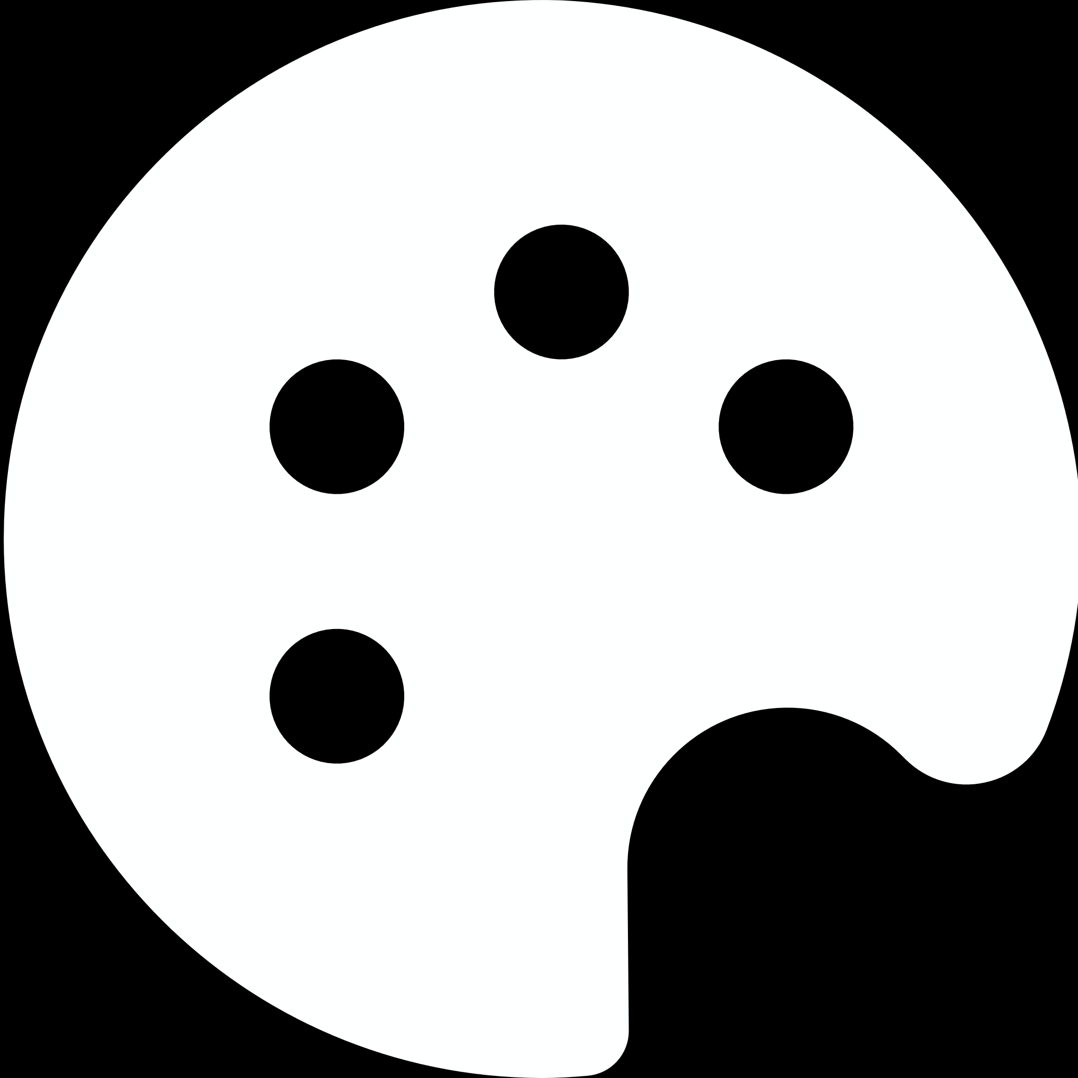



G2
Search...
Admin

Slide 5

G2
Search...
Admin
Introduce Game
Reason for choosing the topic:
The universe is a topic that many people care about and love because of its mystery and attraction. Among those who care and love are also us. Therefore, we have relied on that to build the in-game context in which the player will play the role of the defender of the Earth and attack those who are hunting the Earth with bad intentions.

Slide 6
G2
Search...
Admin
Introduce Game
2. Game Overview
Prepare : To prepare for the game, players need to equip themselves with a spaceship, and the ammunition used for the battlefield. For enemies, there will be 1 spaceship by default and can use many beautiful neon bullets.
Rule : The player will control the character with the main buttons that we implement in the code, the movement buttons we will provide for the W button is to go up, S is to go down, A is to go left, D is to go right. And to shoot bullets, the player will click the left mouse button.
Players only need to control attack the enemy.

Slide 7
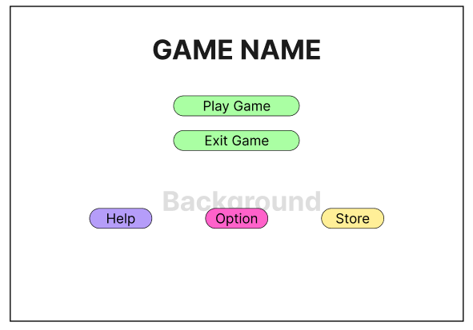
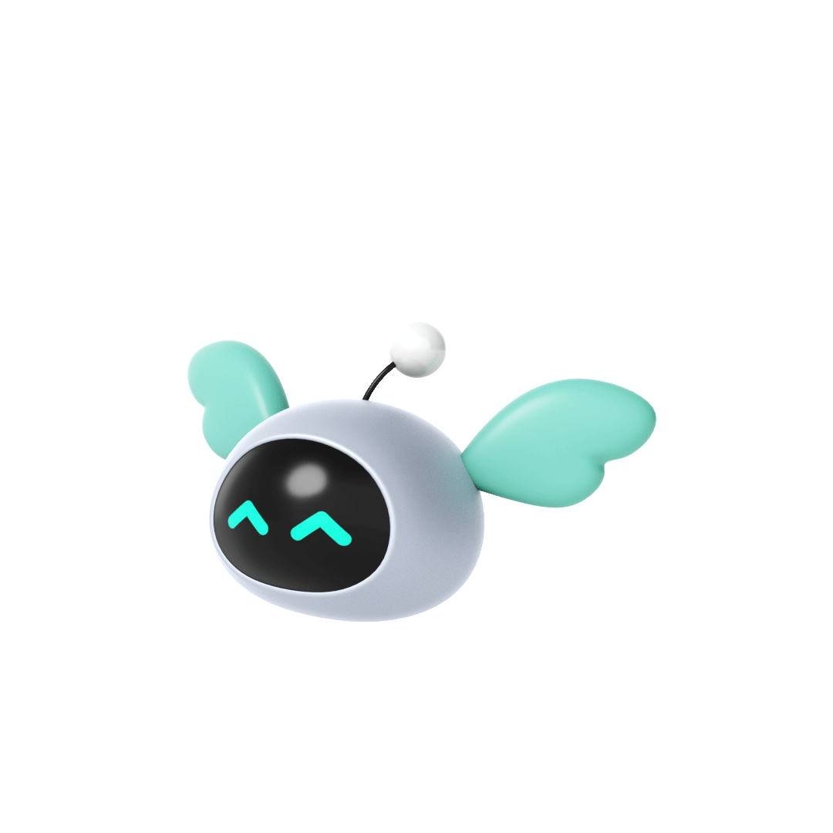
G2
Search...
Admin
Design Game
Menu Interface:
The interface should have a Background and include buttons to handle the transition of the interface.
Play Game : switch to the game interface.
Optional : equipment interface.
Shop: interface to buy items.
Help : tutorial interface.
Exit : Exit the game.

Slide 8
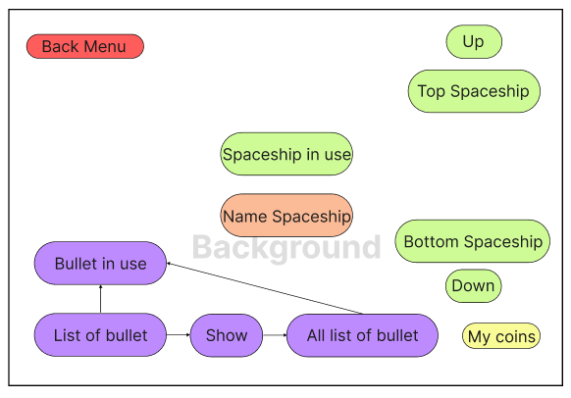
G2
Search...
Admin
Design Game
Option Interface:
In the Options interface, we will have an area showing the spaceship we own along with its name, the bullet we own. List of spaceships and ammo in possession, showing information about the number of coins available.

Slide 9
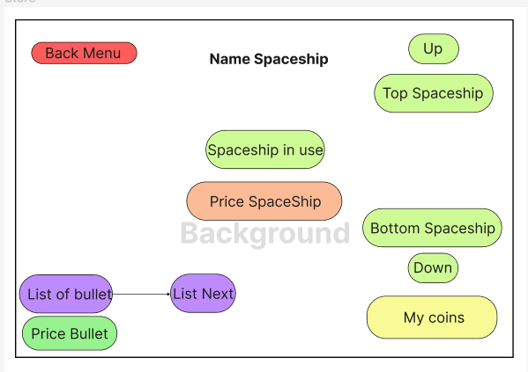
G2
Search...
Admin
Design Game
Store Interface:
In the Store interface will be similar to Options but will add a button that shows the price and the player can click on it to buy. The bullet option that will display the next list of all bullets, each displayed list will have 4 bullets appear.

Slide 10
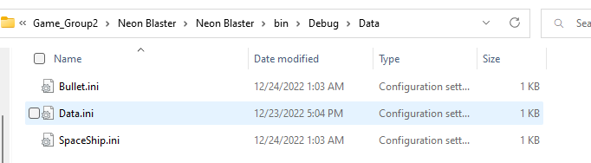

G2
Search...
Admin
Coding Implementation
2. Data Storage Design and Class Library Design
We process data using INI files. Since the article requires more DLLs, we integrate DLL and Data together.
The data we need are: Data (Save Player Coins), SpaceShip (Save Spaceship Ownership Info, Spaceship Name) and Bullet (Save Player Ammo ownership).
Data save path: debug\\Data\\[filename.ini].

Slide 11
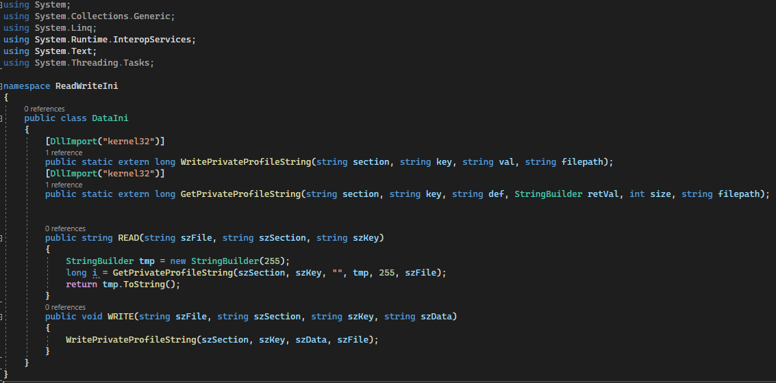
G2
Search...
Admin
Coding Implementation
2. Data Storage Design and Class Library Design
Create the DLL with the Class Library (.Net Framework) project, then create a DataIni.cs class and execute the following code: code in the Class Library as follows:

Slide 12
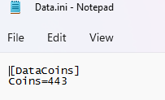
G2
Search...
Admin
Coding Implementation
2. Data Storage Design and Class Library Design
Then we Rebuild Solution, the project will automatically output the DataIni.dll file in the debug folder of the project. Then we put the library into the game project we are building, to use the library we do the following:
READ(path, List of data, name data).
WRITE(path, List of data, name data, data write)

Slide 13
G2
Search...
Admin
Coding Implementation
2. Data Storage Design and Class Library Design
CODE : READ("Data\\Data.ini", " DataCoins", "Coins")
Answer :443
CODE: WRITE("Data\\Data.ini", " DataCoins", " Coins", "10"); Data.ini will update at Data Coins, Coins will be equal to 10.

Slide 14

G2
Search...
Admin
Coding Implementation
Create a project.
Create a project and define the project that we need to work on in Visual Studio 2022 tools. We decided to use Windows Form application because it is easy to use and suitable for simple games. To create this project, do the following:

Slide 15
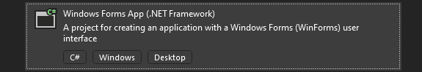
G2
Search...
Admin
Coding Implementation
Create a project.
- Step 1 : Open Visual Studio 2022 tools
- Step 2 : Select Create a new project.
- Step 3 : Select Windows Forms App(.Net Framework) and Click Next .
- Step 4 : Enter a name for the project and select the path to save the project and then Create.

Slide 16
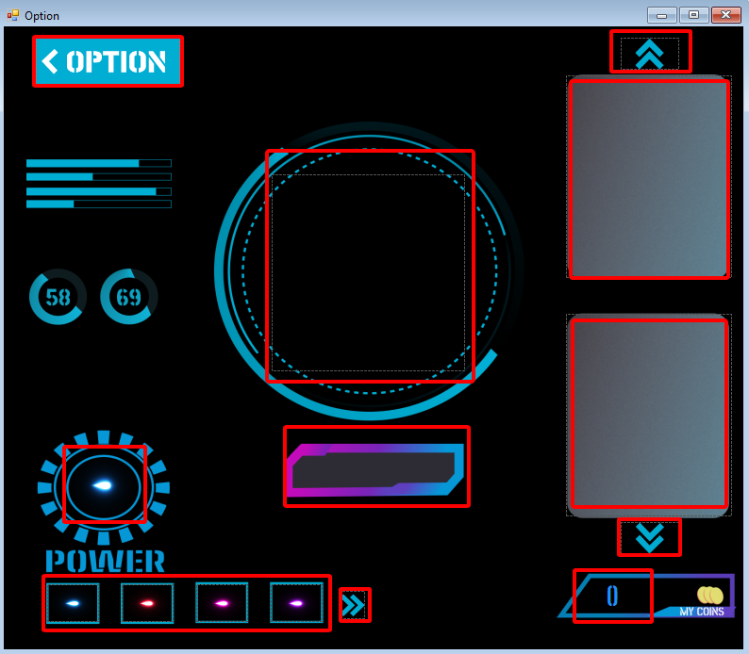
G2
Search...
Admin
Coding Implementation
2. Improved interface and functions in the interface.
Although we already have graphics for the interfaces, there is still something that has to be built in code for the interface to be complete.
- Option :
This is the demo interface that we have included: background and buttons, Label, PictureBox. In which the red box boxes that I marked are the areas where the code needs to be executed to execute.

Slide 17
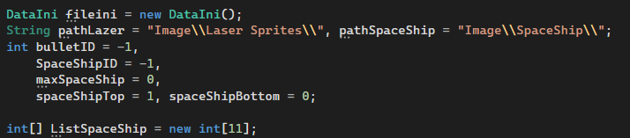
G2
Search...
Admin
Coding Implementation
2. Improved interface and functions in the interface.
First, we will set the necessary user variables, we will set all the relevant variables in the Form Option.

Slide 18
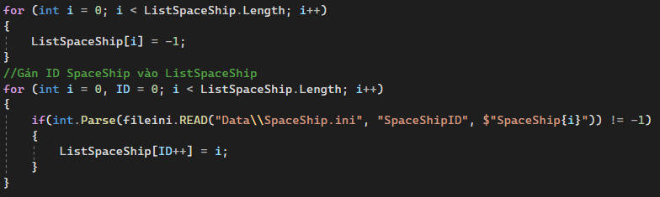
G2
Search...
Admin
Coding Implementation
2. Improved interface and functions in the interface.
We will first proceed to get the entire list of spaceships that the player owns and save into the ListSpaceShip array.

Slide 19
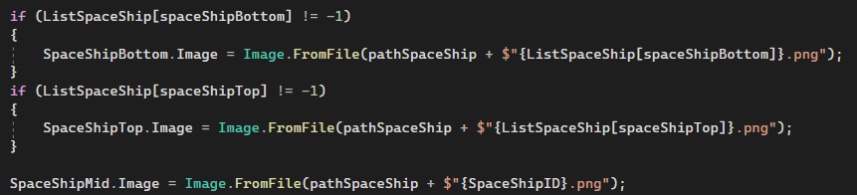
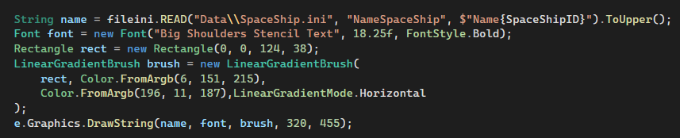
G2
Search...
Admin
Coding Implementation
2. Improved interface and functions in the interface.
We then rely on the ListSpaceShip array to retrieve the spaceships in the system data into the display area.
For SpaceShipTop is the area shown above, SpaceShipBottom is the area shown below.
For the selected spaceship display area, we rely on the player's data to display the craft, with the artwork showing the spacecraft's name.

Slide 20
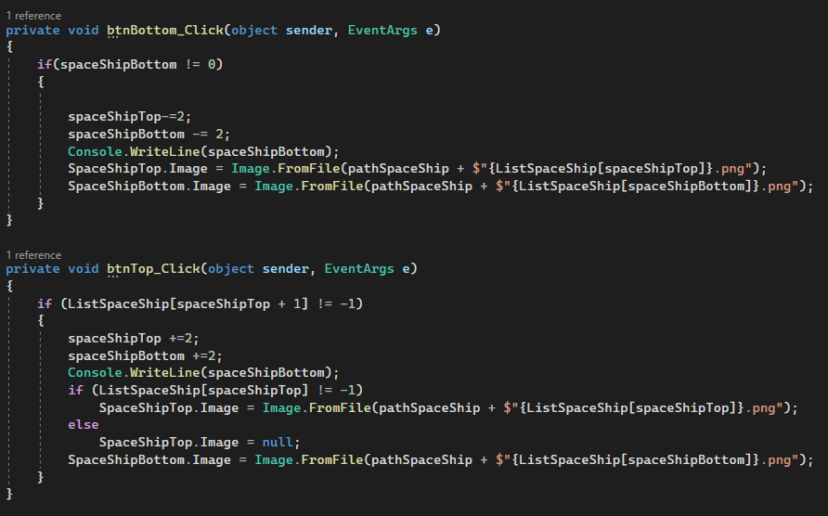
G2
Search...
Admin
Coding Implementation
2. Improved interface and functions in the interface.
Next we will handle 2 buttons up and down to display the spaceship in the list. This is quite simple, we just need to increase the position and check if the position exists or not. Here's how we do it:

Slide 21
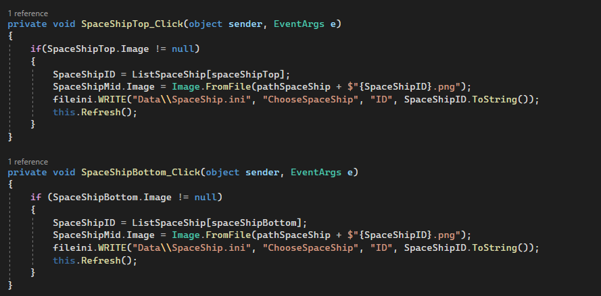
G2
Search...
Admin
Coding Implementation
2. Improved interface and functions in the interface.
Then we perform the operation when we click on any spacecraft we own on the spaceship list display area, they will update the selected spaceship display area.

Slide 22
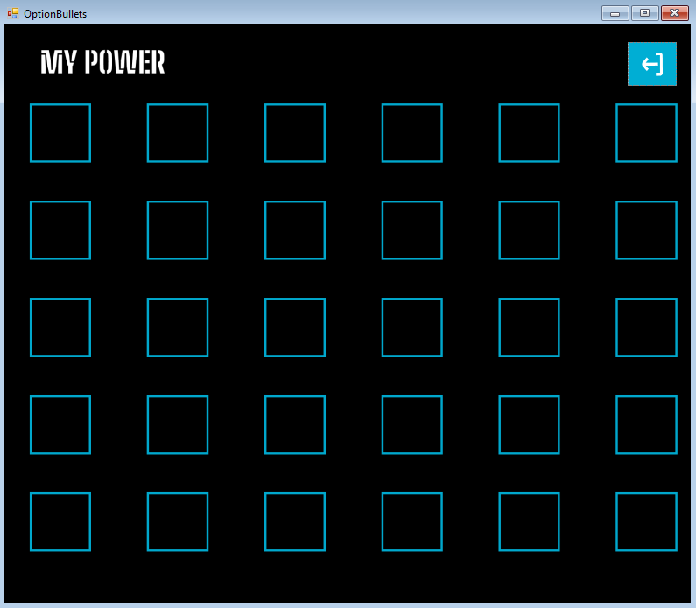
G2
Search...
Admin
Coding Implementation
3. Improved interface and functions in the interface.
Next we will deal with the bullet option, similar to SpaceShip, we save a list of all bullets that the player owns, and then display it, and add the bullet click event.

Slide 23
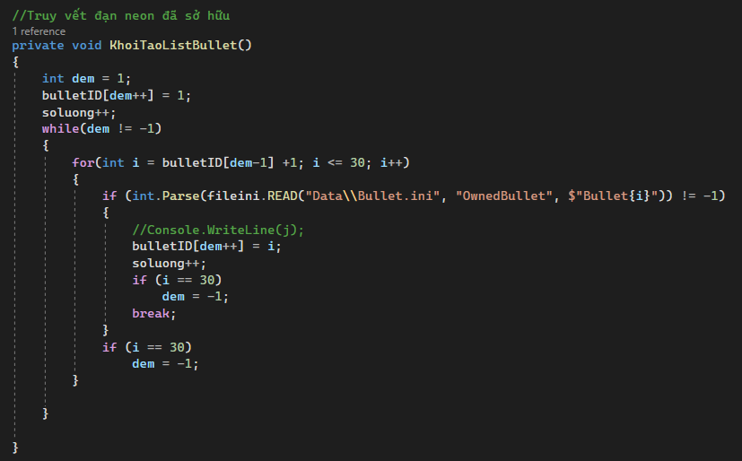
G2
Search...
Admin
Coding Implementation
2. Improved interface and functions in the interface.
The display of the bullet list in possession is quite simple, based on the available graphics, we define to create a 2-dimensional array to display the colored neon bullet list for each cell. First we will save the list of bullets already owned.

Slide 24
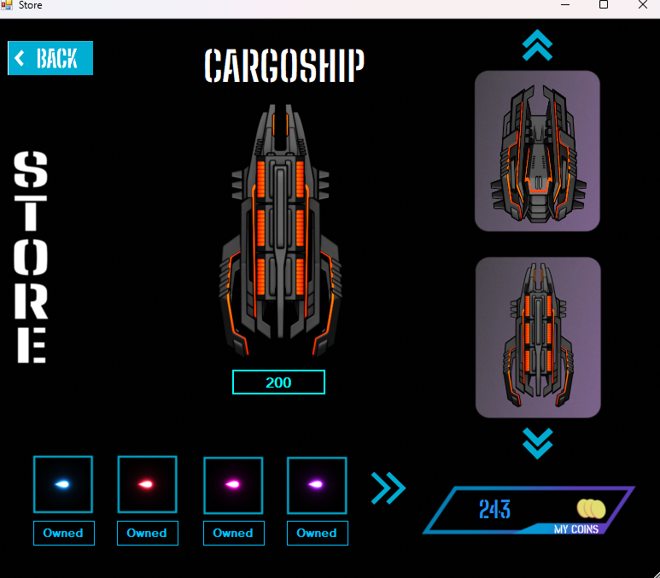
G2
Search...
Admin
Coding Implementation
2. Improved interface and functions in the interface.
Store.
In the Store we also do the same as Options, except that the Store will need more information about the price, whether the item is already owned or not and will display all the items in the system.

Slide 25
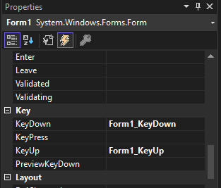
G2
Search...
Admin
Coding Implementation
4. Build Controls Character & Enemy & Bullet
Character control :
Setup Event :
To control the character, we need to trigger the following event in the game form: KeyDown (When the player presses the button) and KeyUp (When the player releases the button).

Slide 26
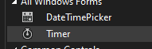
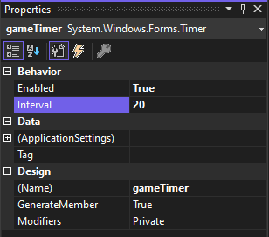
G2
Search...
Admin
Coding Implementation
4. Build Controls Character & Enemy & Bullet
Setup Timer :
Timer Control in C# plays an important role in developing both Client-side, Server-side applications as well as in Windows Services.
To set the Timer we go to the finder, then we set the timer's name to gameTimer, setInterval to 20 and Enabled to true..

Slide 27
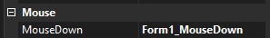
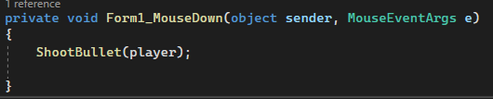
G2
Search...
Admin
Coding Implementation
4. Build Controls Character & Enemy & Bullet
Setup MouseDown :
MouseDown happens when player click, we use this MouseDown for player to shoot bullets.
The installation method is similar to the above, you scroll down to find the Mouse item, you will see MouseDown, then double click on it.
Then build the bullet firing function.

Slide 28
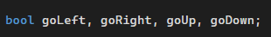
G2
Search...
Admin
Coding Implementation
4. Build Controls Character & Enemy & Bullet
Build Code Move :
In the code interface, we set the move state for the character of data type bool : goLeft, goRight, goUp, goDown.

Slide 29
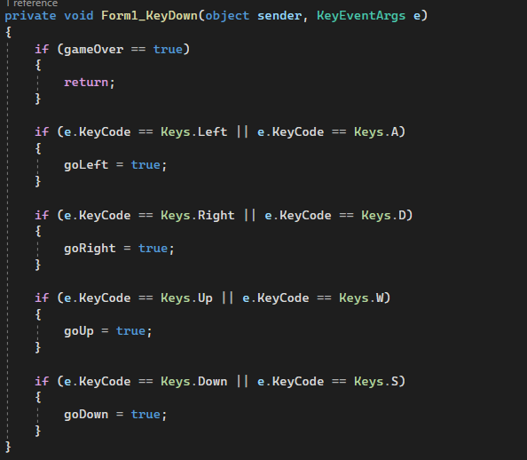
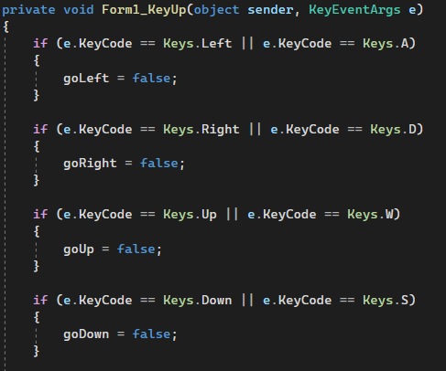
G2
Search...
Admin
Coding Implementation
4. Build Controls Character & Enemy & Bullet
We click on KeyDown, and KeyUp. At KeyDown we set the variable names just set above to true, and KeyUp is the opposite. We use the W button for goUp, S for goDown, A for goLeft and D for goRight.

Slide 30
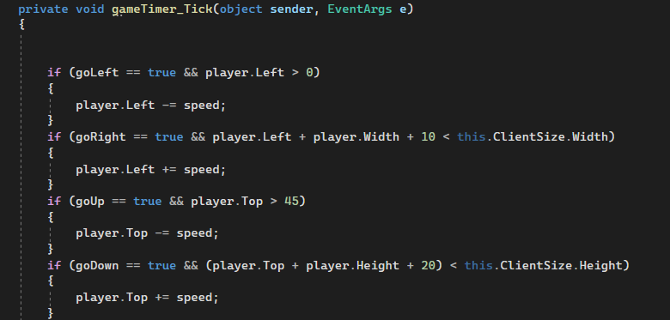
G2
Search...
Admin
Coding Implementation
4. Build Controls Character & Enemy & Bullet
At Timer, we will rely on bool data types to determine the character to move, if it is true, it will execute the move, until the player releases the button, it will return false, then the move will also stop.

